Slide 1
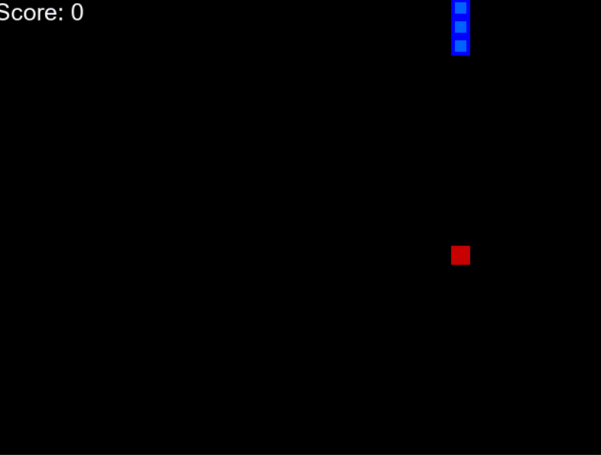
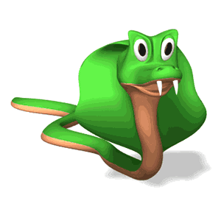
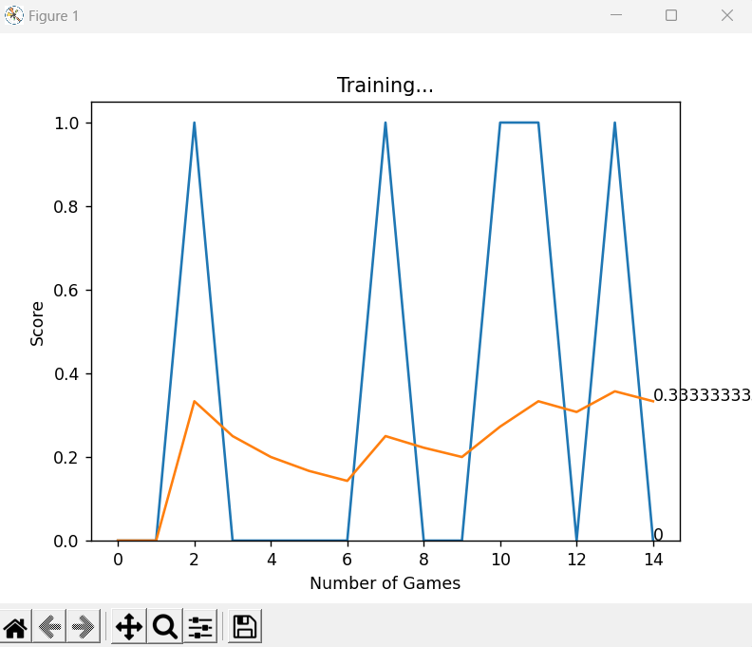
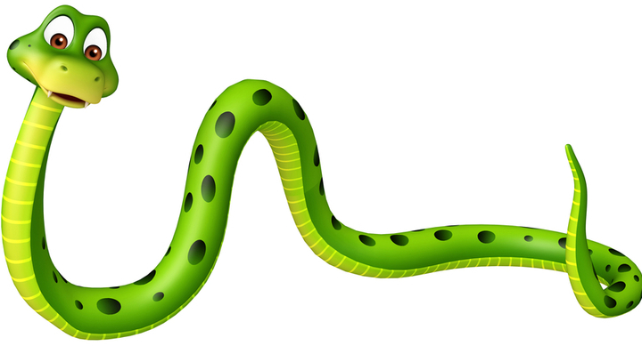
AI-Based Snake Game

Slide 2
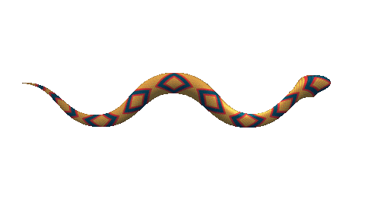
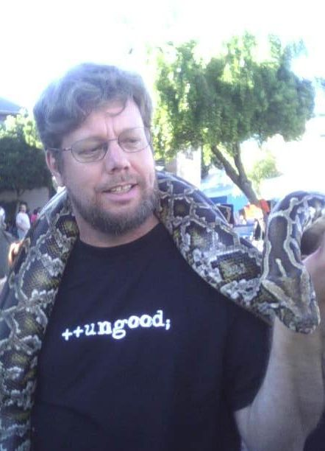
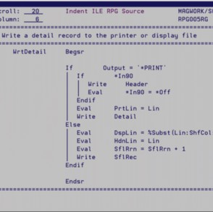
What, Why, when, how, who only Python?
Guido Van Rossum(1980s)
Implementation began in 1989
Successor of ABC language

Slide 3
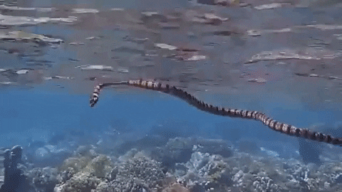
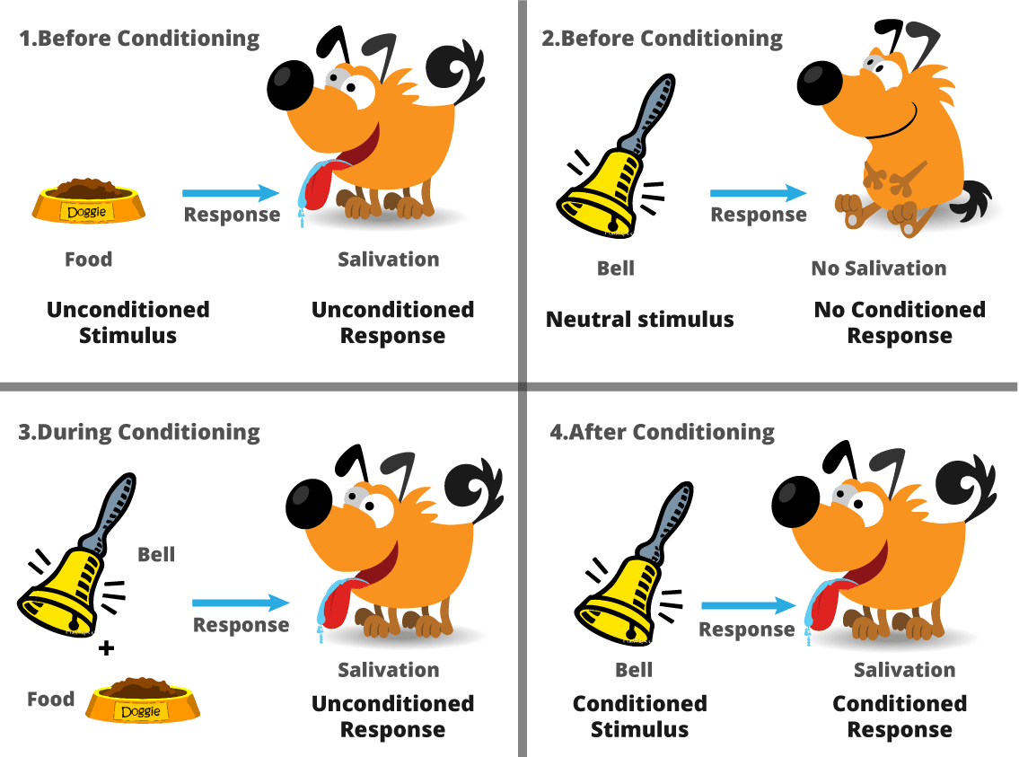
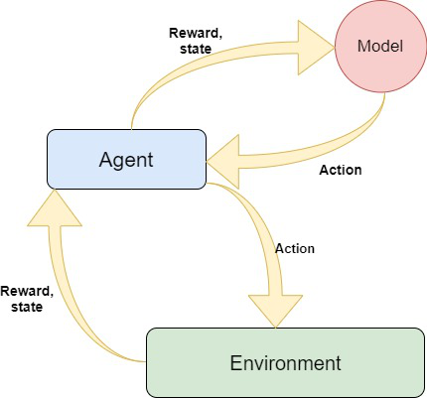
Prerequisites
Reinforcement learning
Deep learning(Dense Neural Network)
Pygame

Slide 4
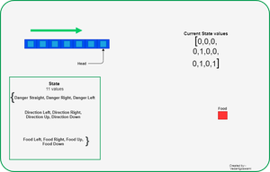
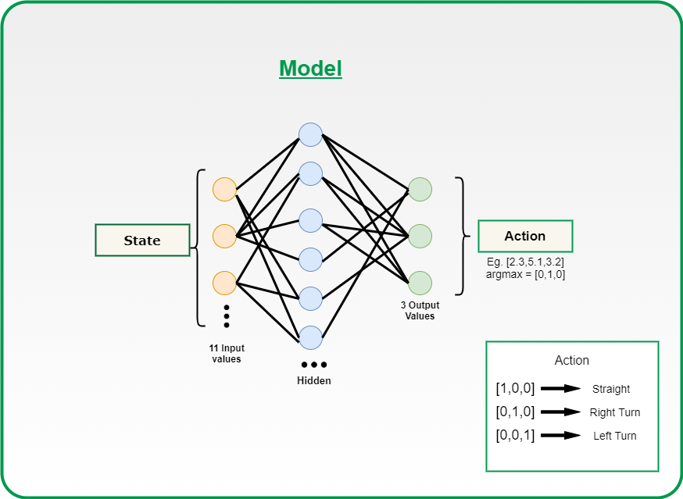
Environment
Model

Slide 5
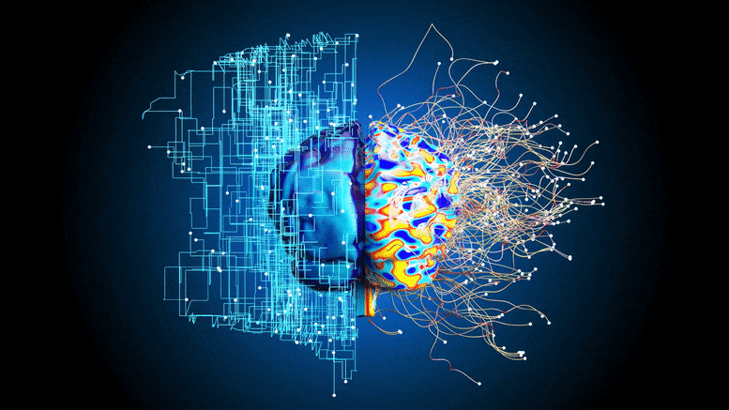
Deep learning(DENSE neural network)
Bellman Equation
Learning rate Discount Rate
New Q(s,a) = Q(s,a) + α[R(s,a) + γmaxQ(s’,a’)-Q(s,a)]
New Q value Current maximum expected Current Q values
for the state Q value future reward
And action
Reward for taking
an action in a state

Slide 6
Implementation
Basic Snake Game
Use of Reinforcement learning
Use of Deep learning

